Slide 1
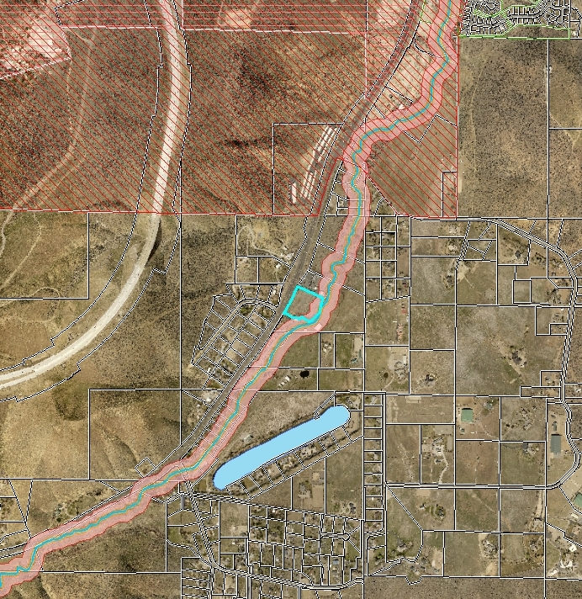
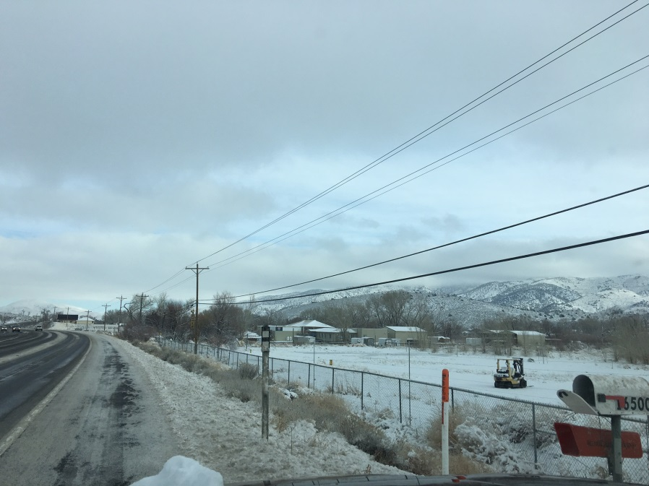
WVAR16-0002 Sierra RV
16400 S. Virginia
Street (old 395 S)
4 acre parcel
Subject parcel

Slide 2
Variance Requested
Permit a commercial use without commercial structure
Allow 8 foot high fence on front property line
Reduce landscaping
Eliminate lighting requirement
Use all-weather base material for parking area

Slide 3
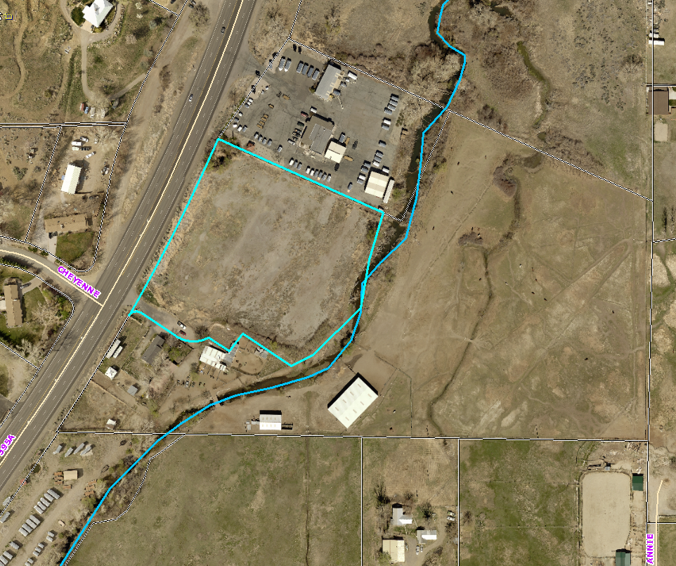
Surrounding uses
Trailers Plus
Single family residences on west side of Old 395 S
Pasture & outbuildings
2 single family homes
Steamboat Trailers
Notes:
Steamboat Trailer south
Trailers plus

Slide 4
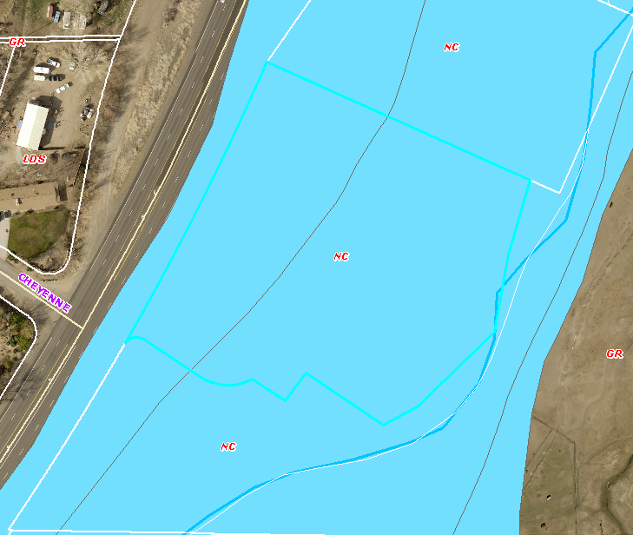
Analysis
Entire site located in FEMA 100 year flood area
Site is several feet lower than road
Consistent with “Dark Sky” standards
Riparian vegetation lining Steamboat Creek
FEMA 100 year flood

Slide 5
Reviewing Agencies
Planning and Development – permitted use limited, operational conditions, landscaping between commercial and residential uses
Truckee Meadows Fire Protection District – access, defensible space, fire suppression
Nevada Department of Transportation – new encroachment permit required, no signs in R/W

Slide 6
Citizen Advisory Board
South Truckee Meadows/Washoe Valley CAB
Location is between two existing trailer sales and service establishments
Conditions of approval limits the use to Recreational Vehicle and related apparatus
Cannot be used for other types of commercial storage or another commercial use without amending variance or bring the site up to current standards.
CAB recommended approval unanimously

Slide 7
Findings
Special circumstances - 100 year flood plain, elevation change from roadway to property line
No detriment - Conditions of approval limit use; screening abutting residential use; less impact to Steamboat Creek
No special privileges - Use is similar to adjacent property; consistent with “rural” character
Use authorized - Use allowed per the South Valleys Area Plan.

Slide 8
Conditions of Approval
Variance is for proposed use only (Storage of Recreational Vehicles and related apparatus)
6-inch all-weather base material for parking area
No parking or storage outside of fenced area
No signs
Landscaping buffer on south side of property
Water for fire suppression
NDOT permit for access from Highway

Slide 9
Motion
I move that, after giving reasoned consideration to the information contained in the staff report and information received during the public hearing, the Washoe County Board of Adjustment approve Variance Case No. WVAR16-0005 for Sierra RV Super Center, Inc., with the conditions included in Exhibit A to the staff report for this matter, having made all four required findings in accordance with Washoe County Code Section 110.804.25.

